Slide 1
Online Upgrade ~ Ubuntu 18.04.5 to 20.04.1
Waikato Linux Users Group
19 Oct 2020
Ian Stewart

Slide 2
Online Upgrade ~ Ubuntu 18.04.5 to 20.04.1
Ubuntu 18.04.x | Release Date | Other Releases | Release Date
Ubuntu 18.04 (dot 0) | 2018 Apr
Ubuntu 18.04.1 | 2018 Jul
LTS Online Upgrade | 2018 Jul ?
 |  | Ubuntu 18.10 | 2018 Oct
Ubuntu 18.04.2 | 2019 Feb
 |  | Ubuntu 19.04 | 2019 Apr
Ubuntu 18.04.3 | 2019 Aug
 |  | Ubuntu 19.10 | 2019 Oct
Ubuntu 18.04.4 | 2020 Feb
 |  | Ubuntu 20.04 | 2020 Apr
Ubuntu 18.04.5 | 2020 Aug
 |  | Ubuntu 20.04.1 | 2020 Aug
LTS Online Upgrade | 2020 Oct

Slide 3
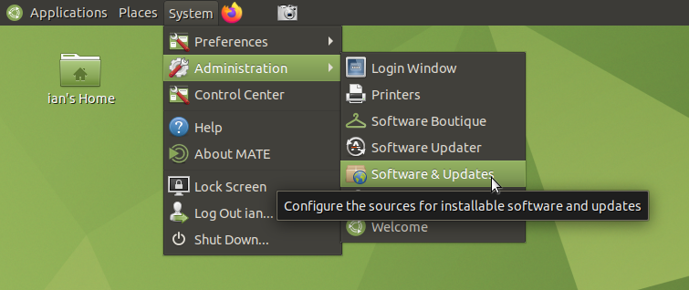
Upgrading Ubuntu 18.04.5 to 20.04.1
LTS Notification...

Slide 4
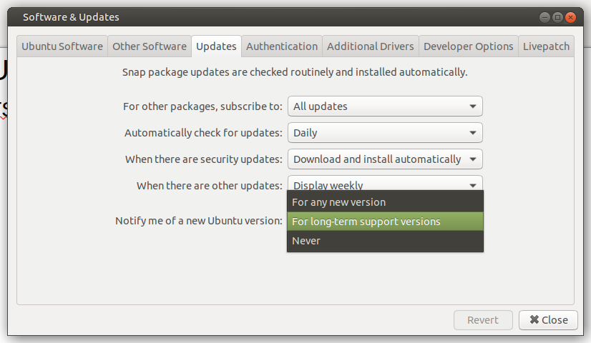
Upgrading Ubuntu 18.04.5 to 20.04.1
LTS Notification...

Slide 5
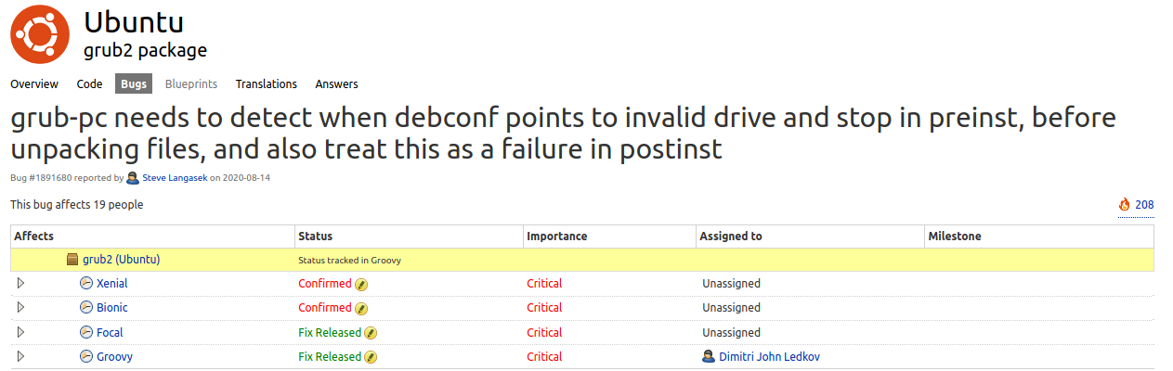
Upgrading Ubuntu 18.04.5 to 20.04.1
Upgrade Blockers...

Slide 6
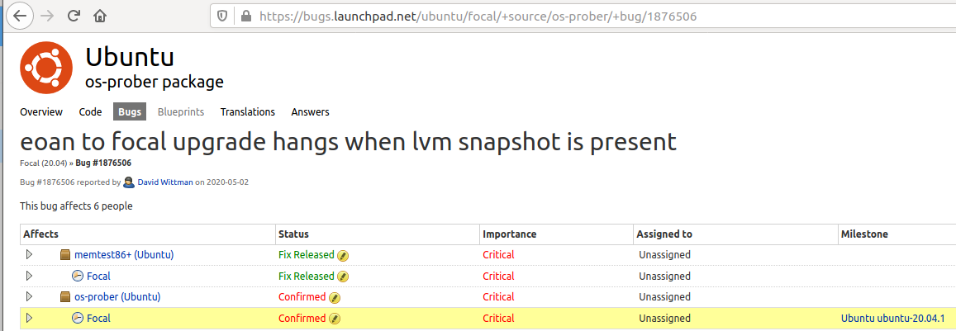
Upgrading Ubuntu 18.04.5 to 20.04.1
Upgrade Blockers...

Slide 7
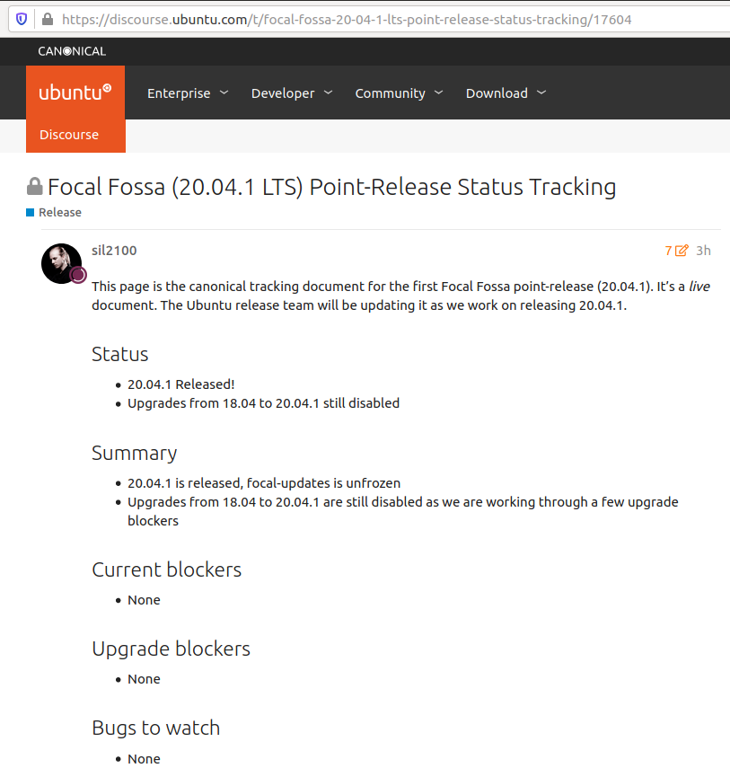
Upgrading Ubuntu 18.04.5 to 20.04.1
Sep 2020

Slide 8
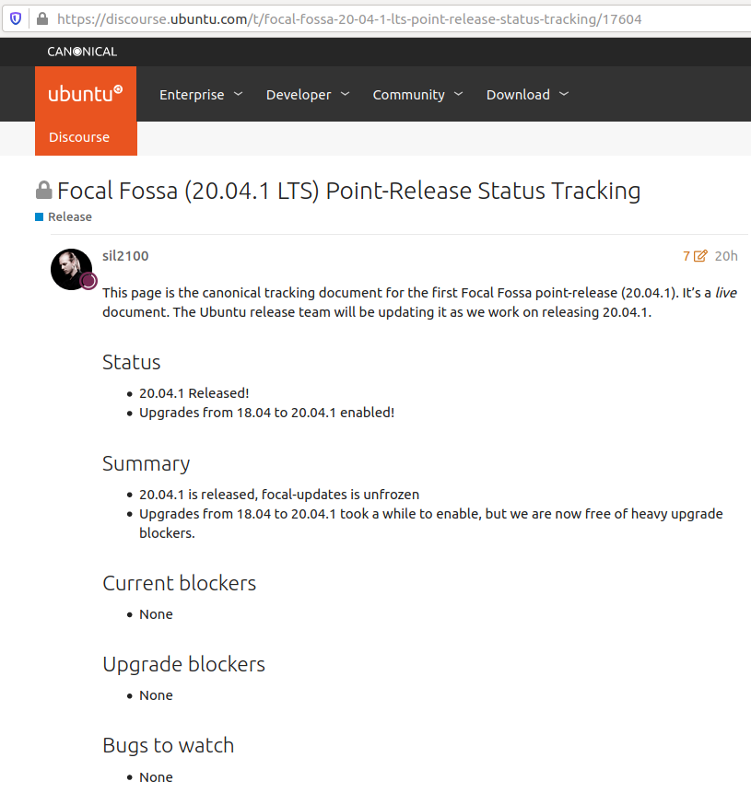
Upgrading Ubuntu 18.04.5 to 20.04.1
Oct 2020

Slide 9
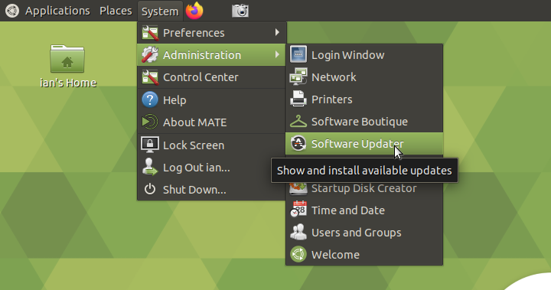
Software Updater
Slide

Slide 10
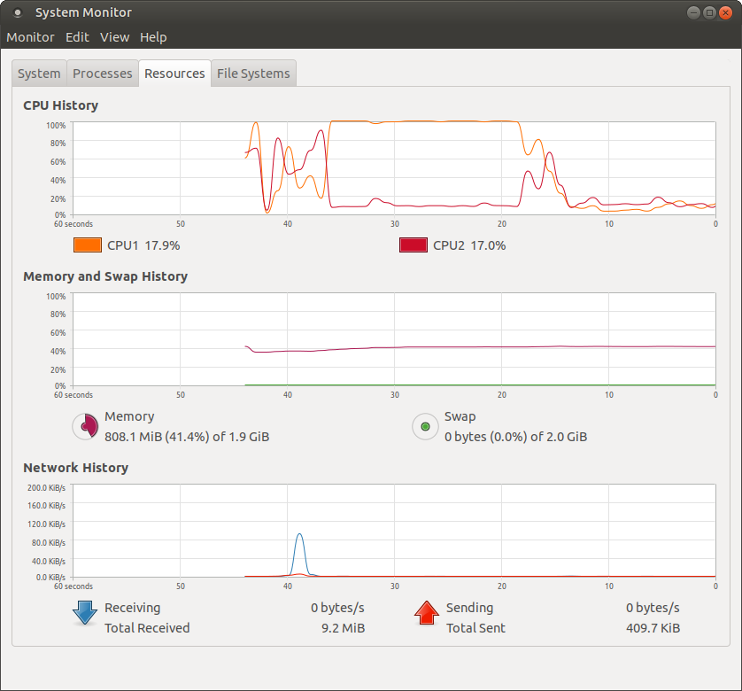
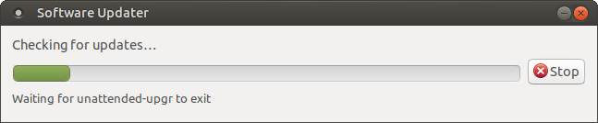
Software Updater
Getting up-to-date

Slide 11
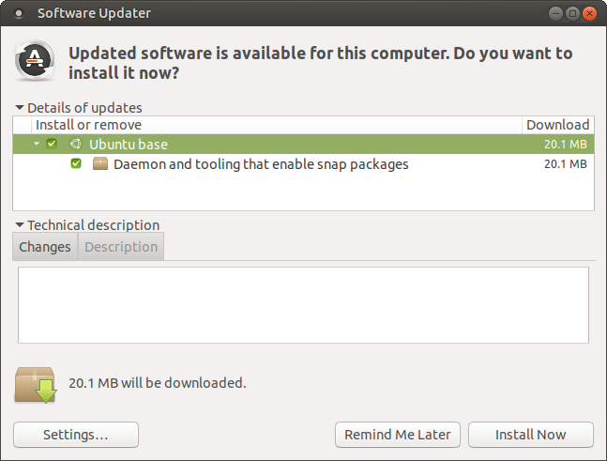
Software Updater
Getting up-to-date

Slide 12
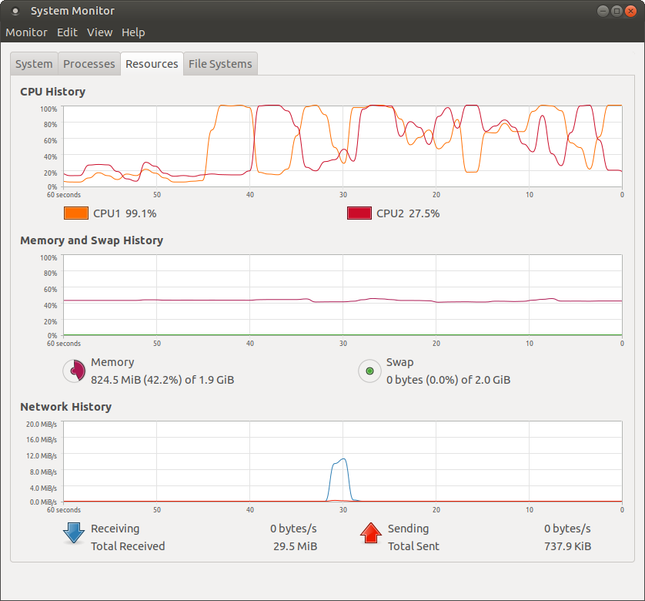
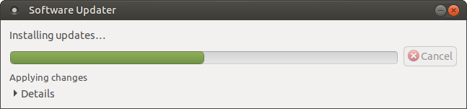
Software Upgrade
Getting up-to-date

Slide 13
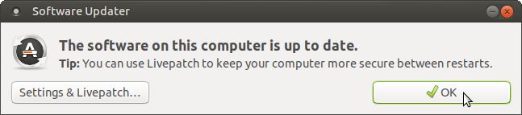
Software Updater
Up-to-date – No upgrade to 20.04

Slide 14
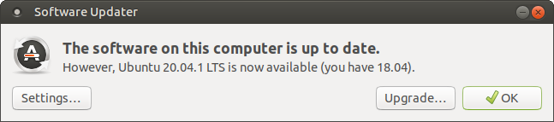
Software Updater
Up-to-date ~ Upgrade to 20.04 offered

Slide 15
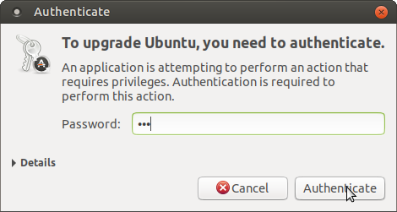
Upgrade to 20.04
Authenticate

Slide 16
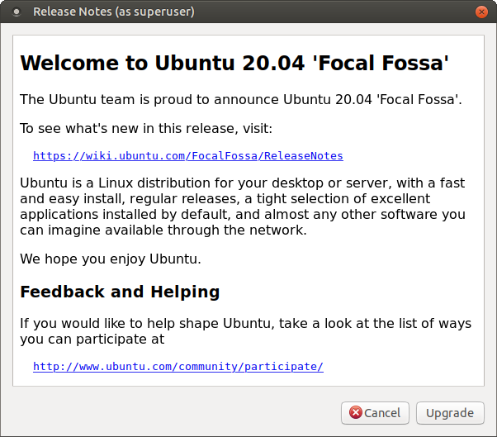
Upgrade to 20.04
Welcome

Slide 17
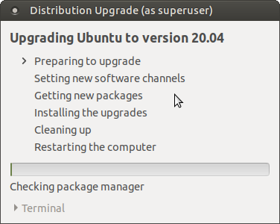
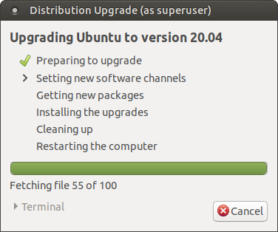
Upgrade to 20.04
Preparing

Slide 18
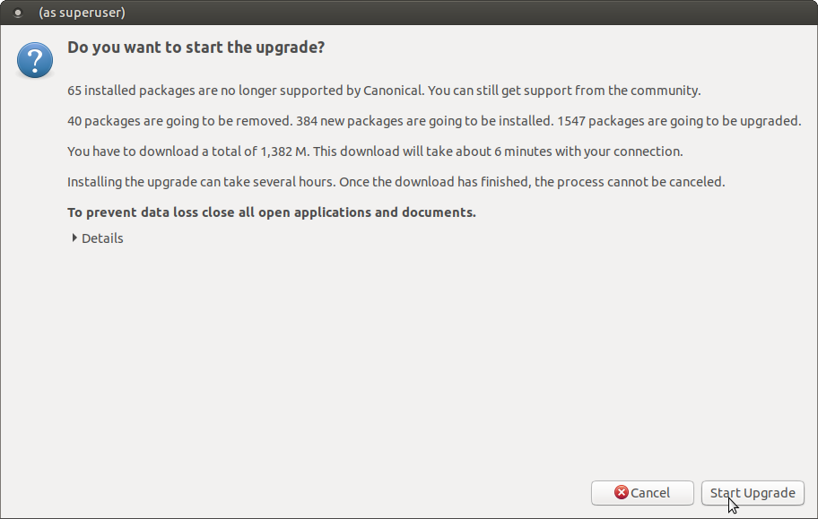
Upgrade to 20.04
Start

Slide 19
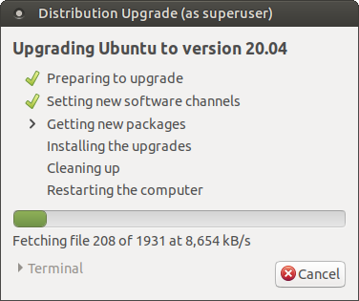
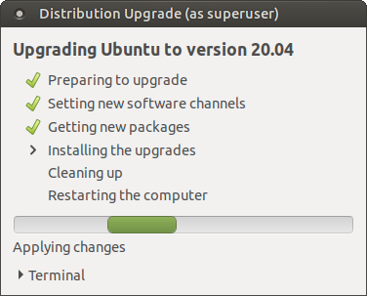
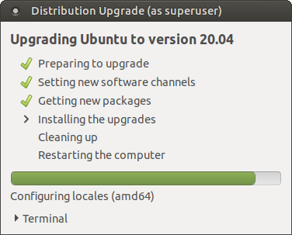
Upgrade to 20.04
Upgrade in progress

Slide 20
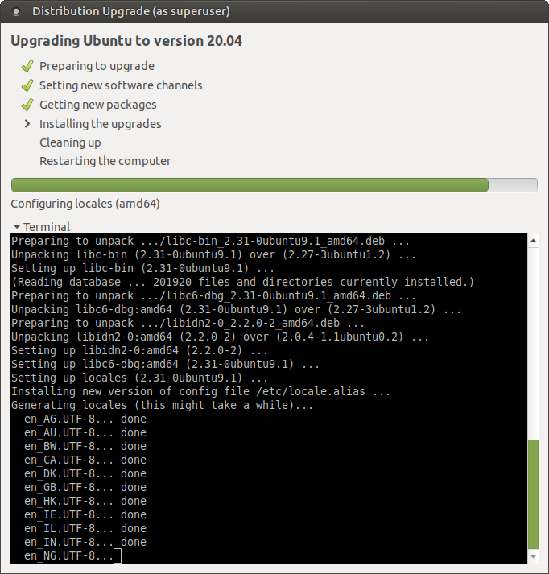
Upgrade to 20.04
Display Terminal

Slide 21
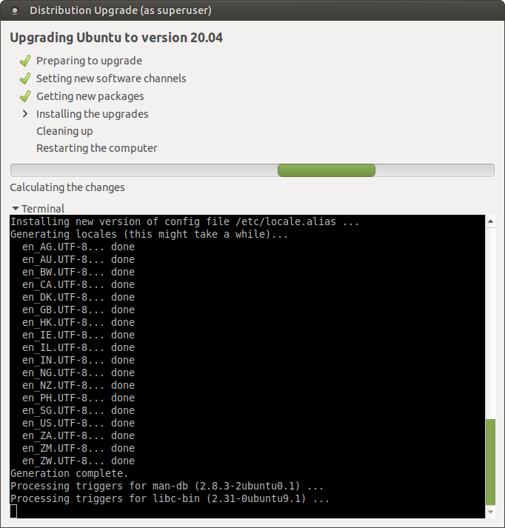
Upgrade to 20.04
Calculating Changes

Slide 22
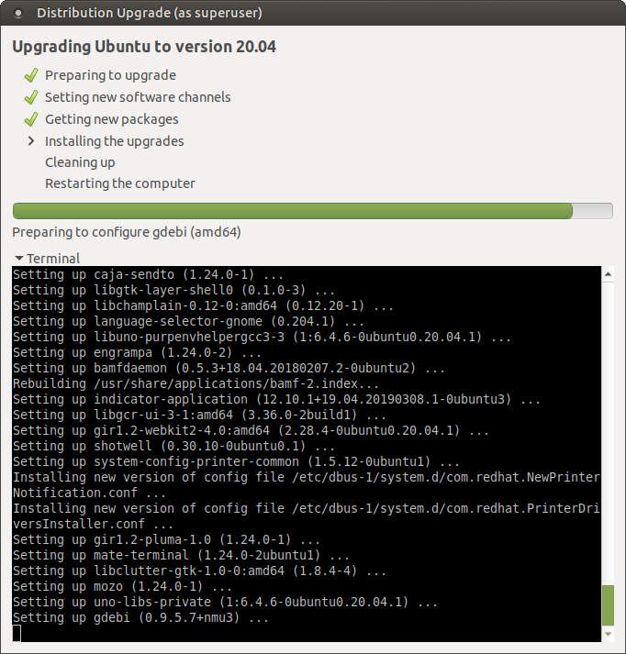
Upgrade to 20.04
45 Minutes

Slide 23
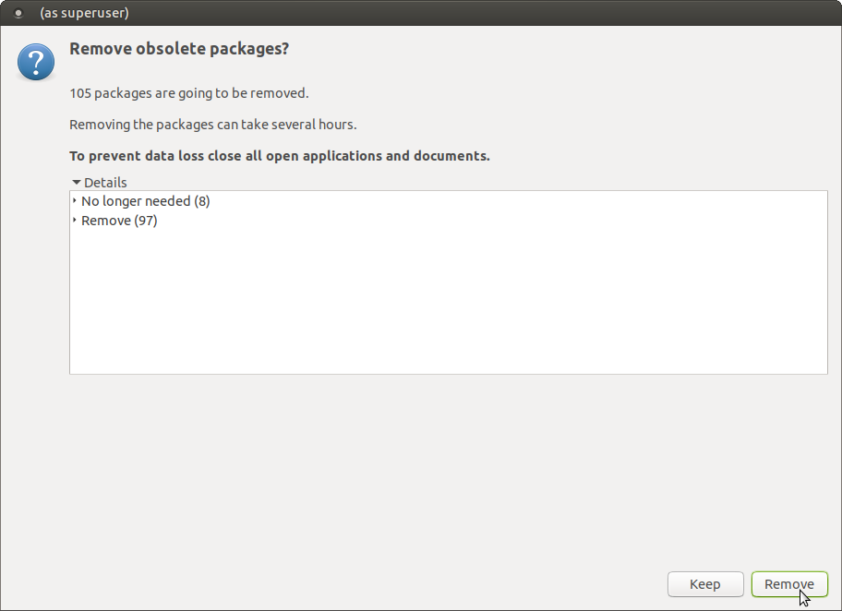
Upgrade to
20.04
Obsolete
Last 3 mins

Slide 24
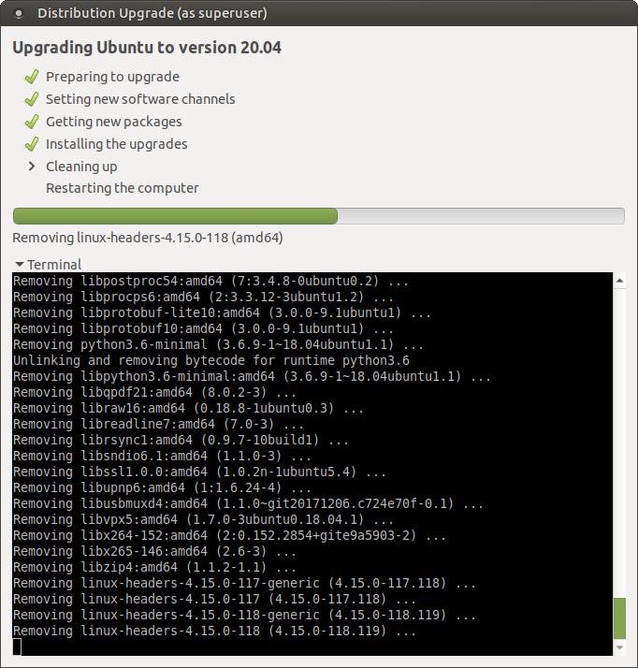
Upgrade to 20.04
Removing

Slide 25
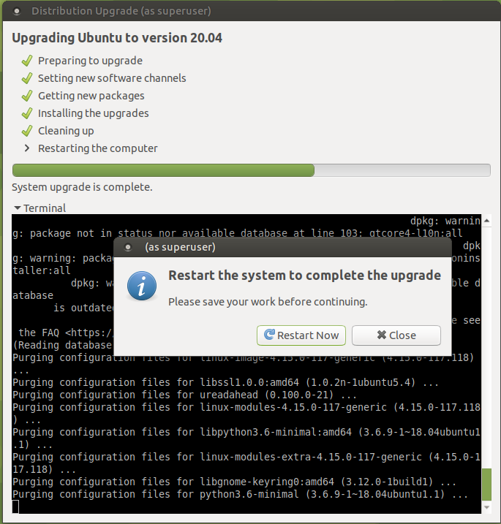
Update to 20.04
Restart

Slide 26
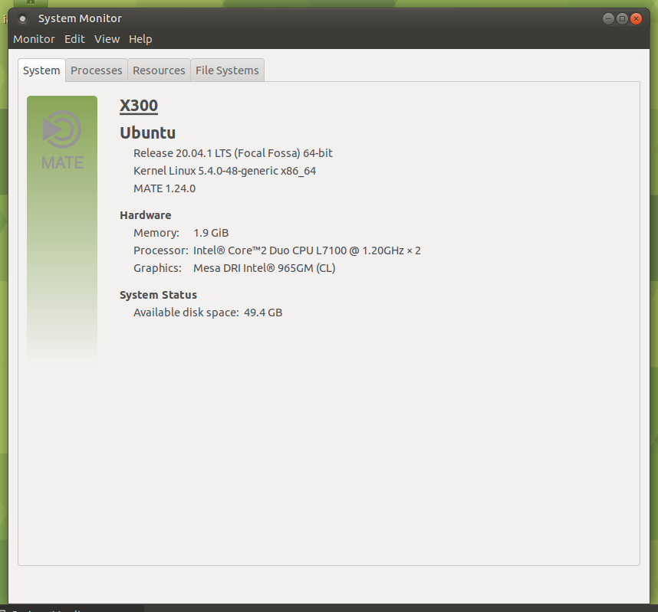
Updated to 20.04
After reboot.

Slide 27
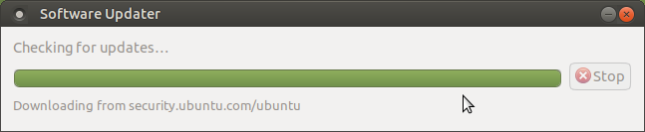
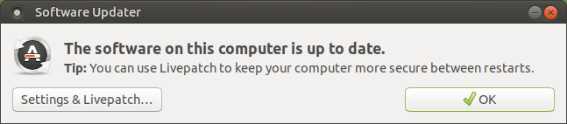
Updated to 20.04
Check Up-to-date

Slide 28
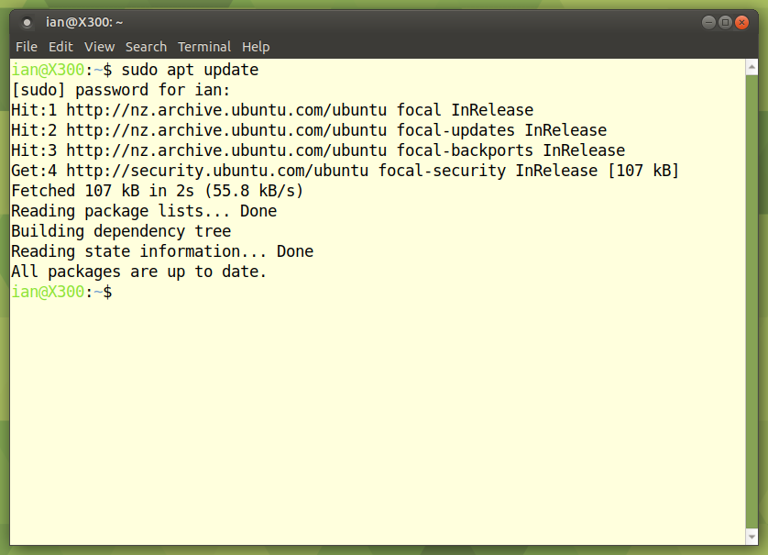
Updated to 20.04
Command Line check up-to-date

Slide 29
End
Questions.

